Slide 1
Classification

Slide 2
Data Mining: Data mining in general terms means mining or digging deep into data that is in different forms to gain patterns, and to gain knowledge on that pattern.
In the process of data mining, large data sets are first sorted, then patterns are identified and relationships are established to perform data analysis and solve problems.

Slide 3
Classification
It is a data analysis task, i.e. the process of finding a model that describes and distinguishes data classes and concepts.
Classification is the problem of identifying to which of a set of categories (subpopulations), a new observation belongs to, on the basis of a training set of data containing observations and whose categories membership is known.

Slide 4
Before starting any project, we need to check its feasibility.
In this case, a classifier is required to predict class labels such as ‘Safe’ and ‘Risky’ for adopting the Project and to further approve it. It is a two-step process such as:
Learning
Classification

Slide 5
Learning Step (Training Phase): Construction of Classification Model.
Different Algorithms are used to build a classifier by making the model learn using the training set available.
The model has to be trained for the prediction of accurate results.
Classification Step: Model used to predict class labels and testing the constructed model on test data and hence estimate the accuracy of the classification rules.

Slide 6
Training and Testing:
Suppose there is a person who is sitting under a fan and the fan starts falling on him, he should get aside in order not to get hurt. So, this is his training part to move away.
While Testing if the person sees any heavy object coming towards him or falling on him and moves aside then the system is tested positively and if the person does not move aside then the system is negatively tested. The same is the case with the data, it should be trained in order to get the accurate and best results.

Slide 7
There are certain data types associated with data mining that actually tells us the format of the file (whether it is in text format or in numerical format).

Slide 8
Attributes – Represents different features of an object. Different types of attributes are:
Binary: Possesses only two values i.e. True or False Example: Suppose there is a survey evaluating some products. We need to check whether it’s useful or not. So, the Customer has to answer it in Yes or No. Product usefulness: Yes / No
Symmetric: Both values are equally important in all aspects
Asymmetric: When both the values may not be important.

Slide 9
Nominal: When more than two outcomes are possible. It is in Alphabet form rather than being in Integer form. Example: One needs to choose some material but of different colors. So, the color might be Yellow, Green, Black, Red. Different Colors: Red, Green, Black, Yellow
Ordinal: Values that must have some meaningful order. Example: Suppose there are grade sheets of few students which might contain different grades as per their performance such as A, B, C, D Grades: A, B, C, D

Slide 10
Continuous: May have an infinite number of values, it is in float type Example: Measuring the weight of few Students in a sequence or orderly manner i.e. 50, 51, 52, 53 Weight: 50, 51, 52, 53
Discrete: Finite number of values. Example: Marks of a Student in a few subjects: 65, 70, 75, 80, 90 Marks: 65, 70, 75, 80, 90

Slide 11
Classifiers can be categorized into two major types:
Discriminative: It is a very basic classifier and determines just one class for each row of data. It tries to model just by depending on the observed data, depends heavily on the quality of data rather than on distributions. Example: Logistic Regression

Slide 12
Generative: It models the distribution of individual classes and tries to learn the model that generates the data behind the scenes by estimating assumptions and distributions of the model. Used to predict the unseen data. Example: Naive Bayes Classifier

Slide 13
Detecting Spam emails by looking at the previous data.
Suppose 100 emails and that too divided in 1:4 i.e. Class A: 25%(Spam emails) and Class B: 75%(Non-Spam emails).
Now if a user wants to check that if an email contains the word cheap, then that may be termed as Spam. It seems to be that in Class A(i.e. in 25% of data), 20 out of 25 emails are spam and rest not.
And in Class B(i.e. in 75% of data), 70 out of 75 emails are not spam and rest are spam. So, if the email contains the word cheap, what is the probability of it being spam ?? (= 80%)

Slide 14
Classifiers Of Machine Learning
Decision Trees
Bayesian Classifiers
Neural Networks
K-Nearest Neighbour
Support Vector Machines
Linear Regression
Logistic Regression

Slide 15
Associated Tools and Languages: Used to mine/ extract useful information from raw data.
Main Languages used: R, SAS, Python, SQL
Major Tools used: RapidMiner, Orange, KNIME, Spark, Weka
Libraries used: Jupyter, NumPy, Matplotlib, Pandas, ScikitLearn, NLTK, TensorFlow, Seaborn, Basemap, etc.

Slide 16
Supervised learning
Supervised learning, as the name indicates, has the presence of a supervisor as a teacher.
Basically supervised learning is when we teach or train the machine using data that is well labelled.
Which means some data is already tagged with the correct answer.
After that, the machine is provided with a new set of examples(data) so that the supervised learning algorithm analyses the training data(set of training examples) and produces a correct outcome from labelled data.

Slide 17
For instance, suppose you are given a basket filled with different kinds of fruits. Now the first step is to train the machine with all the different fruits one by one like this:
If the shape of the object is rounded and has a depression at the top, is red in color, then it will be labeled as –Apple.
If the shape of the object is a long curving cylinder having Green-Yellow color, then it will be labeled as –Banana.

Slide 18
Supervised learning is classified into two categories of algorithms:
Classification: A classification problem is when the output variable is a category, such as “Red” or “blue” , “disease” or “no disease”.
Regression: A regression problem is when the output variable is a real value, such as “dollars” or “weight”.

Slide 19
Now suppose after training the data, you have given a new separate fruit, say Banana from the basket, and asked to identify it.
Since the machine has already learned the things from previous data and this time has to use it wisely.
It will first classify the fruit with its shape and color and would confirm the fruit name as BANANA and put it in the Banana category.
Thus the machine learns the things from training data(basket containing fruits) and then applies the knowledge to test data(new fruit).

Slide 20
Unsupervised learning
Unsupervised learning is the training of a machine using information that is neither classified nor labeled and allowing the algorithm to act on that information without guidance. Here the task of the machine is to group unsorted information according to similarities, patterns, and differences without any prior training of data.
Unlike supervised learning, no teacher is provided that means no training will be given to the machine. Therefore the machine is restricted to find the hidden structure in unlabeled data by itself.

Slide 21
For instance, suppose it is given an image having both dogs and cats which it has never seen.
Thus the machine has no idea about the features of dogs and cats so we can’t categorize it as ‘dogs and cats ‘.
But it can categorize them according to their similarities, patterns, and differences, i.e., we can easily categorize the above picture into two parts.
The first may contain all pics having dogs in them and the second part may contain all pics having cats in them.
Here you didn’t learn anything before, which means no training data or examples.

Slide 22
It allows the model to work on its own to discover patterns and information that was previously undetected. It mainly deals with unlabelled data.
Unsupervised learning is classified into two categories of algorithms:
Clustering: A clustering problem is where you want to discover the inherent groupings in the data, such as grouping customers by purchasing behavior.
Association: An association rule learning problem is where you want to discover rules that describe large portions of your data, such as people that buy X also tend to buy Y.

Slide 23
Decision Tree Introduction
Decision tree algorithm falls under the category of supervised learning.
They can be used to solve both regression and classification problems.
Decision tree uses the tree representation to solve the problem in which each leaf node corresponds to a class label and attributes are represented on the internal node of the tree.
We can represent any Boolean function on discrete attributes using the decision tree.

Slide 24
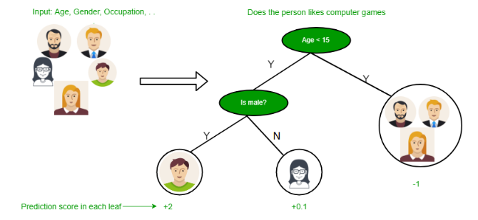

Slide 25
Below are some assumptions that we made while using decision tree:
At the beginning, we consider the whole training set as the root.
Feature values are preferred to be categorical. If the values are continuous then they are discretized prior to building the model.
On the basis of attribute values records are distributed recursively.
We use statistical methods for ordering attributes as root or the internal node.

Slide 26
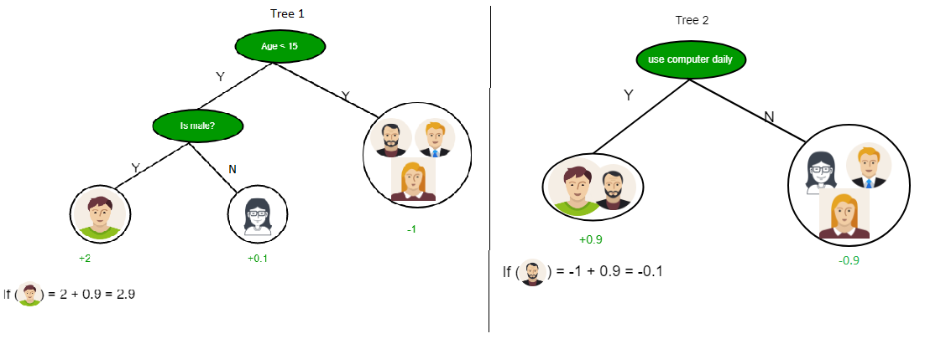

Slide 27
As you can see from the above image that Decision Tree works on the Sum of Product form which is also known as Disjunctive Normal Form. In the above image, we are predicting the use of computer in the daily life of the people.
In Decision Tree the major challenge is to identification of the attribute for the root node in each level. This process is known as attribute selection.

Slide 28
We have two popular attribute selection measures:
Information Gain
Gini Index

Slide 29

1. Information Gain When we use a node in a decision tree to partition the training instances into smaller subsets the entropy changes. Information gain is a measure of this change in entropy. Definition: Suppose S is a set of instances, A is an attribute, S_{v} is the subset of S with A = v, and Values (A) is the set of all possible values of A, then

Slide 30
